Slide 1

Unit-1 Introduction to IT Software Project Management
Project Management Tools (PMT)
2305CS322
Prof. Mayur Padia
Computer Engineering Department
mayur.padia@darshan.ac.in
99255 15118

Slide 2
Outline
Quick Facts
Key Terms
Project and Project Management
Role of Project Manager
System View of Project Management
Focusing on Stakeholder Needs
Project Phases and Its Life Cycle
Project Management Process Group (PMPG)
PMPG and its Mapping to Knowledge Area
Quiz

Slide 3
Quick Facts
Worldwide IT spending is $5.06 trillion in 2024, a 30.71 percent increase from 2020 spending.
By 2027, employers will need nearly 88 million individuals in project management-oriented roles. China and India will represent more than 75 percent of the total project management-oriented employment.
IT spending in India to grow at 9.9%, to cross $59 billion by 2027 (source)
In 2024, the average salary in US dollars for someone in the IT Project Management profession was $1,16,212 per year in United States; $1,40,000 in Australia (the highest-paid country); $22,735 in India.
The top skills employers look for in new college graduates are all related to project management:
Team-work
Decision-making
Problem-solving, and
Verbal Communications

Slide 4
Key Terms
Outcome. An end result or consequence of a process or project. Outcomes can include outputs and artifacts, but have a broader intent by focusing on the benefits and value that the project was undertaken to deliver.
Portfolio. Projects, programs, subsidiary portfolios, and operations managed as a group to achieve strategic objectives.
Product. An artifact that is produced, is quantifiable, and can be either an end item in itself or a component item.
Program. Related projects, subsidiary programs, and program activities that are managed in a coordinated manner to obtain benefits not available from managing them individually.
Project. A temporary endeavor undertaken to create a unique product, service, or result. The temporary nature of projects indicates a beginning and an end to the project work or a phase of the project work. Projects can stand alone or be part of a program or portfolio.
Project Management. The application of knowledge, skills, tools, and techniques to project activities to meet project requirements.

Slide 5
Key Terms (contd.)
Project manager. The person assigned by the performing organization to lead the project team that is responsible for achieving the project objectives. Project managers perform a variety of functions, such as facilitating the project team work to achieve the outcomes and managing the processes to deliver intended outcomes.
Project team. A set of individuals performing the work of the project to achieve its objectives.
Value. The worth, importance, or usefulness of something. Different stakeholders perceive value in different ways. Customers can define value as the ability to use specific features or functions of a product. Organizations can focus on business value as determined with financial metrics, such as the benefits less the cost of achieving those benefits. Societal value can include the contribution to groups of people, communities, or the environment.
A Gantt chart is a standard format for displaying project schedule information by listing project activities and their corresponding start and finish dates in calendar form.
PMI provides certification as a Project Management Profession (PMP). You do not need work experience to qualify for CompTIA’s Project+ certification or PMI’s CAPM certification.

Slide 6
Project and Project Management
Section - 1

Slide 7

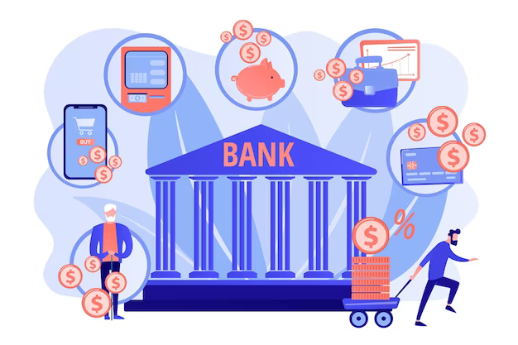
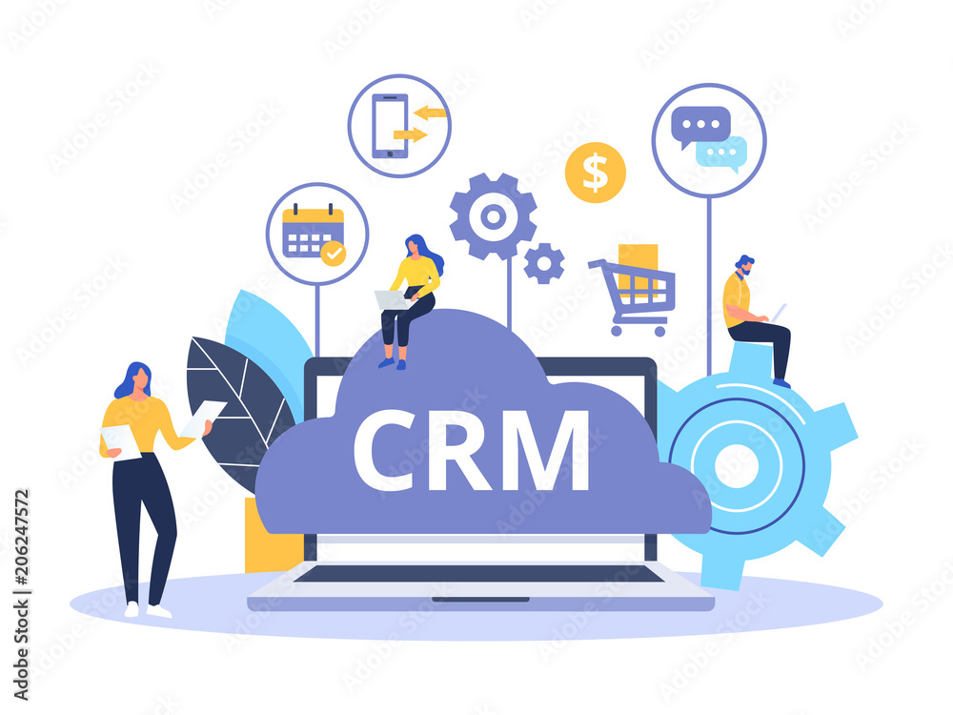
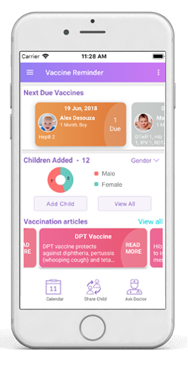
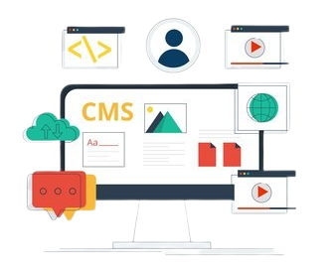


Definition of Project
A Project is “a temporary effort undertaken to create a unique product, service, or result”.
Projects can be large or small and involve one person or thousands of people.
They can be done in one day or take years to complete.
IT projects involve using hardware, software, and networks to create a product, service, or result.

Slide 8
Project Attributes
A project has a unique purpose.
Every project should have a well-defined objective.
A project is temporary.
A project has a definite beginning and end.
A project is developed using progressive elaboration.
Projects are often defined broadly when they begin, and as time passes, the specific details of the project become clearer.
A project requires resources, often from various areas.
Resources include people, hardware, software, and other assets. Many projects cross departmental or other boundaries to achieve their unique purposes. For the IT collaboration project, people from IT, marketing, sales, distribution, and other areas of the company would need to work together to develop ideas. The company might also hire outside consultants to provide input.

Slide 9
Project Attributes (contd.)
A project should have a primary customer or sponsor.
Most projects have many interested parties or stakeholders, but for a project to succeed someone must take the primary role of sponsorship. The project sponsor usually provides the direction and funding for the project.
A project involves uncertainty.
Every project is unique, it is sometimes difficult to define its objectives clearly, estimate how long it will take to complete, or determine how much it will cost. External factors also cause uncertainty, such as a supplier going out of business or a project team member needing unplanned time off.

Slide 10
Project Constraints
Every project is constrained in different ways, often by its scope, time, and cost goals.
These limitations are sometimes referred to in project management as the triple constraint.
To create a successful project, a project manager must consider scope, time, and cost and balance these three often-competing goals.
Scope | Time | Cost
What work will be done as part of the project? | How long should it take to complete the project? | What should it cost to complete the project?
What unique product, service, or result does the customer or sponsor expect from the project? | What is the project’s schedule? How will the team track actual schedule performance? | What is the project’s budget? How will costs be tracked?
How will the scope be verified? | Who can approve changes to the schedule? | Who can authorize changes to the budget?

Slide 11





Project Constraints
Successful project management means meeting all three goals (scope, time and cost) – and satisfying the project’s sponsor.
TIME
QUALITY
TARGET
COST
SCOPE
Quadruple Constraint of Project Management

Slide 12
Project Management
Project management is the application of knowledge, skills, tools, and techniques to project activities to meet project requirements.
Project managers must strive to meet specific scope, time, cost, and quality goals of projects.
They must also facilitate the entire process to meet the needs and expectations of people involved in project activities or affected by them.

Slide 13



Enterprise Success
Project Management Framework
10 Knowledge Area
Tools and Techniques
Portfolio Projects
Scope Management
Time Management
Cost Management
Quality Management
Project Integration Management
Stakeholders’ need and expectations
Project Success
Human Resource Management
Communication Management
Risk Management
Procurement Management
Stakeholder Management

Slide 14

Project Stakeholders
Stakeholders are the people involved in or affected by project activities
They includes
Project sponsor
Project team
Support staff
Customers
Users
Suppliers
Opponents of the project
These stakeholders often have very different needs and expectations and are important throughout the life of a project.

Slide 15




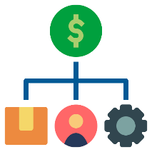


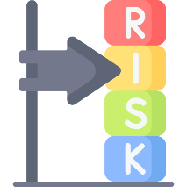


Project Management Knowledge Areas
Integration Management
Scope Management
Time Management
Stakeholder Management
Project Management Knowledge Areas
Cost Management
Procurement Management
Quality Management
Risk Management
Communication Management
Human Resource Management

Slide 16
Project Management Knowledge Areas
Integration Management
Scope Management
Time Management
Stakeholder Management
Project Management Knowledge Areas
Cost Management
Procurement Management
Quality Management
Risk Management
Communication Management
Human Resource Management
Scope Management involves defining and managing all the work required to complete the project successfully.

Slide 17
Project Management Knowledge Areas
Integration Management
Scope Management
Time Management
Stakeholder Management
Project Management Knowledge Areas
Cost Management
Procurement Management
Quality Management
Risk Management
Communication Management
Human Resource Management
Time Management includes estimating how long it will take to complete the work, developing and acceptable project schedule, and ensuring timely completion of the project.

Slide 18
Project Management Knowledge Areas
Integration Management
Scope Management
Time Management
Stakeholder Management
Project Management Knowledge Areas
Cost Management
Procurement Management
Quality Management
Risk Management
Communication Management
Human Resource Management
Cost Management consists of preparing and managing the budget for the project.

Slide 19
Project Management Knowledge Areas
Integration Management
Scope Management
Time Management
Stakeholder Management
Project Management Knowledge Areas
Cost Management
Procurement Management
Quality Management
Risk Management
Communication Management
Human Resource Management
Quality Management ensures that that project will satisfy the stated or implied needs for which it was undertaken.

Slide 20
Project Management Knowledge Areas
Integration Management
Scope Management
Time Management
Stakeholder Management
Project Management Knowledge Areas
Cost Management
Procurement Management
Quality Management
Risk Management
Communication Management
Human Resource Management
Human Resource Management is concerned with making effective use of the people involved with the project.

Slide 21
Project Management Knowledge Areas
Integration Management
Scope Management
Time Management
Stakeholder Management
Project Management Knowledge Areas
Cost Management
Procurement Management
Quality Management
Risk Management
Communication Management
Human Resource Management
Communication Management involves generating, collecting, distributing, and storing project information.

Slide 22
Project Management Knowledge Areas
Integration Management
Scope Management
Time Management
Stakeholder Management
Project Management Knowledge Areas
Cost Management
Procurement Management
Quality Management
Risk Management
Communication Management
Human Resource Management
Risk Management includes identifying, analysing, and responding to risks related to the project.

Slide 23
Project Management Knowledge Areas
Integration Management
Scope Management
Time Management
Stakeholder Management
Project Management Knowledge Areas
Cost Management
Procurement Management
Quality Management
Risk Management
Communication Management
Human Resource Management
Procurement Management involves acquiring or procuring goods and services for a project from outside the performing organization.

Slide 24
Project Management Knowledge Areas
Integration Management
Scope Management
Time Management
Stakeholder Management
Project Management Knowledge Areas
Cost Management
Procurement Management
Quality Management
Risk Management
Communication Management
Human Resource Management
Stakeholder Management includes identifying and analysing stakeholder needs while managing and controlling their engagement throughout the life of the project.

Slide 25
Project Management Knowledge Areas
Integration Management
Scope Management
Time Management
Stakeholder Management
Project Management Knowledge Areas
Cost Management
Procurement Management
Quality Management
Risk Management
Communication Management
Human Resource Management
Integration Management is an overarching function that affects and is affected by all of the other knowledge areas.

Slide 26




Project Management Tools and Techniques
Knowledge Area
Scope
Management
Time
Management
Cost
Management
Quality
Management
Tools and Techniques
Statements of work
Scope Management Plans
Scope Verification Techniques
Scope Change Controls
Project Network diagrams
Critical Path Analysis
Crashing
Fast tracking
Schedule performance
Measurements
Project budgets
Net present value
Return on investment
Payback analysis
Earned value management
Project portfolio management
Cost estimates/Cost baselines
Cost management plans
Quality metrics
Checklists
Quality control charts
Pareto diagrams
Fishbone diagrams
Maturity models
Statistical methods
Test plans
Super Tools
Scope Statements
Work breakdown structures
Requirement Analysis
Gantt Charts

Slide 27



Project Management Tools and Techniques
Knowledge Area
Human Resource
Management
Communications
Management
Risk
Management
Tools and Techniques
Motivation techniques
Empathic listening
Responsibility assignment matrices
Project organizational charts
Resource histograms
Team building exercises
Conflict management
Communications media selection
Status reports / Virtual communications
Templates/ Project websites
Risk management plans
Risk registers
Probability/impact matrices
Risk rankings
Super Tools
Kick-off meetings
Progress reports

Slide 28


Project Management Tools and Techniques
Knowledge Area
Procurement
Management
Integration
Management
Tools and Techniques
Make-or-buy analyses
Contracts
Requests for proposals or quotes
Source selections
Supplier evaluation matrices
Project selection methods
Project management methodologies
Stakeholder analyses
Work requests
Project charters
Change control boards
Project review meetings
Super Tools
Project management software
Change requests
Lessons-learned reports

Slide 29
Criteria to Measure a Project Success
The project met scope, time, and cost goals.
The project satisfied the customer/sponsor.
The results of the project met its main objective, such as making or saving a certain amount of money, providing a good return on investment, or simply making the sponsors happy.
Project Success Factor Vs. % of Responses
Executive Management Support:
Proper Planning:
User
Involvement:
Clear Statement of Requirements:
9.6%
Realistic Expectations:
13.9%
15.9%
13.0%
8.2%
Clear Vision & Objectives:
Competent Staff:
Smaller Project Milestones:
2.9%
Hard-Working, Focused Staff:
7.2%
Ownership:
7.7%
5.3%
2.4%

Slide 30
Best Practices to excel in Project Delivery
Use an integrated toolbox.
Companies that consistently succeed in managing projects clearly define what needs to be done in a project, by whom, when, and how.
They use an integrated toolbox, including project management tools, methods, and techniques.
They carefully select tools, align them with project and business goals, link them to metrics, and provide them to project managers to deliver positive results.
Grow project leaders.
Companies that excel in project management often grow or develop their project leaders internally, providing them with career opportunities, training, and mentoring.
Develop a streamlined project delivery process.
All project leaders use a shared road map, focusing on key business aspects of their projects while integrating goals across all parts of the organization.
Measure project health using metrices.
Metrics often include customer satisfaction, return on investment, and percentage of schedule buffer consumed.

Slide 31

Speedee Service System from the movie “The Founder”

Slide 32
The Role of the Project Manager
Section - 2

Slide 33
The Role of the Project Manager
Project Managers are organized, passionate, and goal-oriented individuals who drive business results by leading projects.
They are also change agents who work well under pressure and enjoy challenging work environments.

Slide 34












Top Most Important Skills and Competencies for Project Managers
Critical thinking, problem solving
Understanding and balancing of priorities
Conflict resolution, conflict management
People Skills
Strength at building teams
Leadership
Listening
Verbal Communication
Integrity, Ethical behaviour, consistency
Strength at building trust

Slide 35
System View of Project Management
Section - 3

Slide 36
A System View of Project Management
The term systems approach describe a holistic and analytical approach to solving complex problems that includes using a systems philosophy, systems analysis, and systems management.
Systems are sets of interacting components that work within an environment to fulfil some purpose.
In an organization, people in various roles work together to design, develop, deliver, and sell various products and services.
A systems philosophy is an overall model for thinking about things as systems.

Slide 37
A System View of Project Management (contd.)
Systems analysis is a problem-solving approach that requires defining the scope of the system, dividing it into components, and then identifying and evaluating its problems, opportunities, constraints, and needs.
Systems management addresses the business, technological, and organizational issues associated with creating, maintaining, and modifying a system.
The top management and project managers must follow a systems philosophy.
They must use systems analysis to address needs with a problem-solving approach.
They must use systems management to identify key issues in business, technological, and organizational spheres related to each project in order to identify and satisfy key stakeholders, and do what is best for the entire organization.

Slide 38
The Three-Sphere Model for Systems Management
How will the project affect stakeholder who already uses the system?
Who will develop special applications if needed?
Who will train stakeholders?
What will be the project cost?
What will it cost stakeholder?
What will support cost be?
What will be the impact on business?
{Profit/ Sales}
Business
What applications will be required?
What will be the HW/SW requirements?
Organization
Technology
{Stakeholders}
{H/W, S/W}

Slide 39
Stakeholders
Section - 4

Slide 40

Focusing on Stakeholder Needs
Project Stakeholders are the people involved in or affected by project activities.
Stakeholders can be internal or external to the organization, directly involved in the project, or simply affected by the project.
Internal project stakeholders include the project sponsor, project team, support staff, and internal customers of the project.
Other internal stakeholders include top management, other functional managers, and other project managers.
External project stakeholders include the project’s customers (if they are external to the organization), competitors, suppliers, and other external groups potentially involved in the project or affected by it, such as government officials or concerned citizens.

Slide 41
The Importance of Top Management Commitment
Helping project managers successfully lead projects is the level of commitment and support they receive from top management.
Without this commitment, many projects will fail.
Some projects have a senior manager called a champion who acts as a key advocate for a project.
Top management commitment is crucial to project managers for the following reasons:
Project managers need adequate resources.
To kill a project is to withhold the required money, human resources, and visibility.
Project managers often require approval for unique project needs in a timely manner.
The team might need additional hardware and software halfway through the project for proper testing, or the project manager might need to offer special pay and benefits to attract and retain key project personnel.
Project managers must have cooperation from people in other parts of the organization.
IT projects cut across functional areas, top management must help project managers deal with the political issues that often arise.
Project managers often need someone to mentor and coach them on leadership issues.
Senior managers should take the time to give advice on how to be good leaders.

Slide 42
Project Phase & Life Cycle
Section - 5

Slide 43

Project Phases and the Project Life Cycle
Phases in traditional project management are the concept, development, implementation, and close-out phases.
The PMBOK® Guide, calls these phases starting the project, organizing and preparing, carrying out the project work, and finishing the project.
Project phases vary by project or industry.
Phases break projects down into smaller, more manageable pieces, which will reduce uncertainty.
Some organizations specify a set of life cycles for use in all of their projects.
Some follow common industry practices based on the types of projects involved.

Slide 44
Project Phases and the Project Life Cycle (contd.)
Project life cycles defines:
What work will be performed in each phase?
What deliverables will be produced and when?
Who is involved in each phase?
How management will control and approve work produced in each phase?
A deliverable is a product or service, such as a technical report, a training session, a piece of hardware, or a segment of software code, produced or provided as part of a project.

Slide 45
Project Phases and the Project Life Cycle (contd.)
In early phases of a project life cycle, resource needs are usually lowest and the level of uncertainty is highest.
Project stakeholders have the greatest opportunity to influence the final characteristics of the project’s products, services, or results during the early phases of a project life cycle.
It is much more expensive to make major changes to a project during later phases.
During the middle phases of a project life cycle, the certainty of completing the project improves as it continues and as more information is known about the project requirements and objectives.
More resources are usually needed than during the initial or final phase.
The final phase of a project focuses on ensuring that project requirements were met and that the project sponsor approves completion of the project.

Slide 46
Phases of the Project Life Cycle
Project Feasibility
Project Acquisition
Concept
Development
Implementation
Close-out
1
2
3
3
Business case
Project Management Plan
Execution of work packages
Completed Work
Preliminary Cost Estimate
Budgetary Cost Estimate
Definitive cost estimate
Lessons Learned
Performance reports
Customer acceptance
2-level WBS
3+-level WBS
Sample deliverables for each phase

Slide 47
Phases of the Project Life Cycle (contd.)
The first two traditional project phases (concept and development) focus on planning, and are often referred to as project feasibility.
The last two phases (implementation and closeout) focus on delivering the actual work, and are often referred to as project acquisition.
Each phase of a project should be successfully completed before the team moves on to the next phase.
This project life cycle approach provides better management control and appropriate links to the ongoing operations of the organization.

Slide 48
Phases of the Project Life Cycle (contd.)
Concept phase
Managers usually develop a business case, which describes the need for the project and basic underlying concepts.
A preliminary or rough cost estimate is developed in this first phase, and an overview of the required work is created.
Tool for creating an overview of the required work is a work breakdown structure (WBS).
A WBS outlines project work by decomposing the work activities into different levels of tasks.
The WBS is a deliverable-oriented document that defines the total scope of the project.
In the concept phase, a WBS usually has only two levels.
Development Phase
Here, the project team creates more detailed project management plans, a more accurate cost estimate, and a more thorough WBS.
This phased approach minimizes the time and money spent developing inappropriate projects.
A project idea must pass the concept phase before evolving into the development phase.

Slide 49
Phases of the Project Life Cycle (contd.)
Implementation Phase
In this phase, the project team creates a definitive or very accurate cost estimate, delivers the required work, and provides performance reports to stakeholders.
The project team usually spends the bulk of its efforts and money during the implementation phase of projects.
Close-out Phase
In it, all of the work is completed, and customers should accept the entire project.
The project team should document its experiences on the project in a lessons-learned report.
They would ensure that any contracts with suppliers were completed and that appropriate payments were made.
They would transition future work related to the project to other parts of the organization.

Slide 50
Product Life Cycles
A systems development life cycle (SDLC) is a framework for describing the phases of developing information systems.
Some popular models of an SDLC include the waterfall model, the spiral model, the incremental build model, the prototyping model, and the Rapid application development (RAD) model.
These life cycle models are examples of a predictive life cycle, meaning that the scope of the project can be articulated clearly and the schedule and cost can be predicted accurately.
The project team spends a large portion of the project attempting to clarify the requirements of the entire system and then producing a design.
Users are often unable to see any tangible results in terms of working software for an extended period.

Slide 51
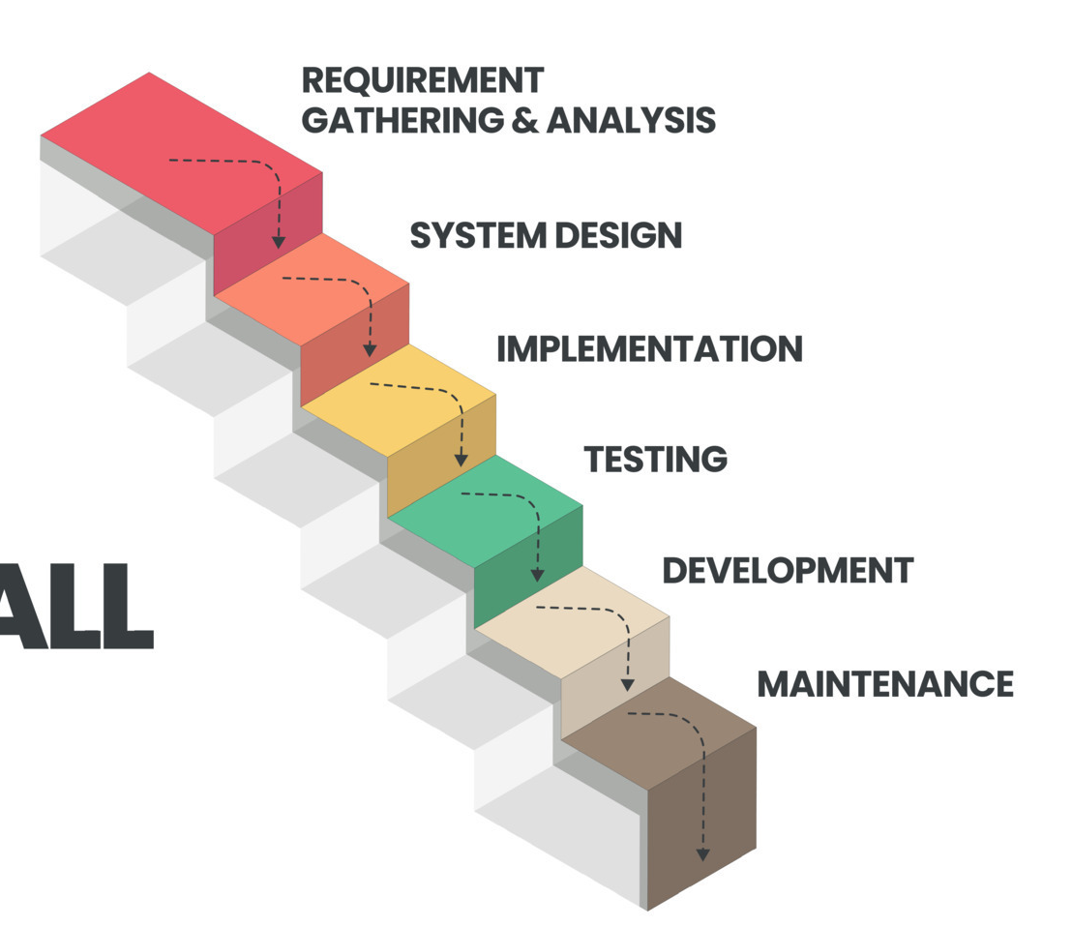
Waterfall Model
The waterfall life cycle model has well-defined, linear stages of systems analysis, system design, implementation, testing, development, and maintenance.
This life cycle model assumes that requirements will remain stable after they are defined.
The waterfall life cycle model is used when risk must be tightly controlled and when changes must be restricted after the requirements are defined.

Slide 52
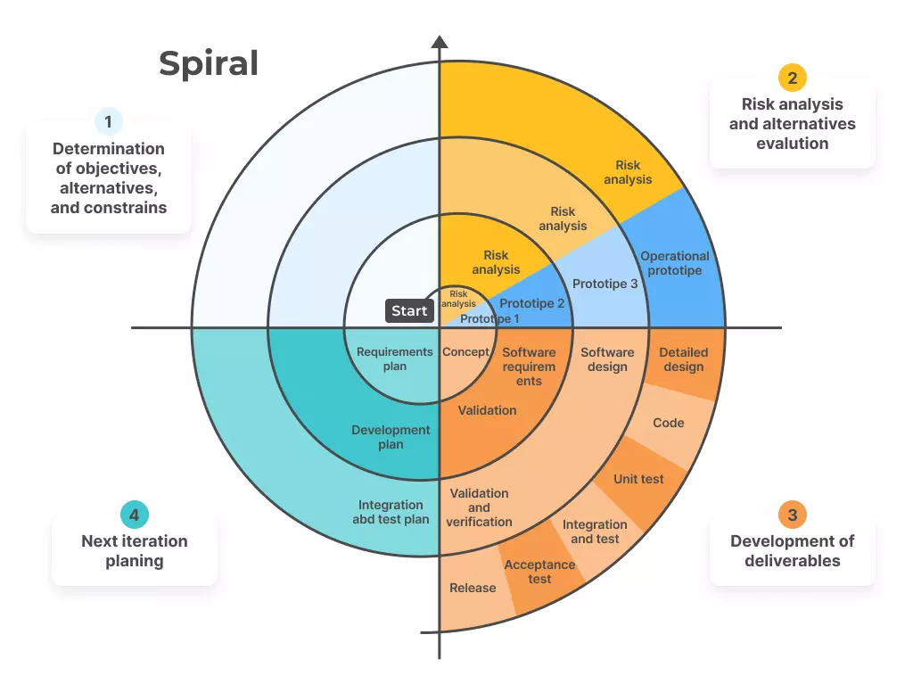
Spiral Model
The spiral life cycle model recognizes the fact that most software is developed using an iterative or spiral approach rather than a linear approach.
The project team is open to changes and revisions later in the project life cycle, and returns to the requirements phase to more carefully clarify and design the revisions.
This approach is suitable for projects in which changes can be incorporated with reasonable cost increases or with acceptable time delays.

Slide 53





Incremental Model
Design & Development
Testing
Design of the system functionality and the development technique is completed successfully in this phase.
Examines the performance of each current function and new capabilities.
Implementation
Requirement Analysis
Enables the coding step of the development system. After completion of this phase the number of working products increase and updates.
Product Analysis team identifies the needs. It is critical for developing software using the incremental methodology
Phases of Incremental
Model
Requirement Analysis
Design & Development
Testing
Implementation

Slide 54
Prototyping Model & RAD Model
Prototyping life cycle model
The prototyping life cycle model is used for developing software prototypes to clarify user requirements for operational software.
It requires heavy user involvement, and developers use a model to generate functional requirements and physical design specifications simultaneously.
This approach is often used in systems that involve a great deal of user interface design, such as website projects, in systems that automate previously manual functions, or in systems that change the nature of how something is done, such as mobile applications.
RAD life cycle model
The RAD life cycle model uses an approach in which developers work with an evolving prototype.
This life cycle model also requires heavy user involvement and helps produce systems quickly without sacrificing quality.
Developers use RAD tools such as computer-aided software engineering (CASE), joint requirements planning (JRP), and joint application design (JAD) to facilitate rapid prototyping and code generation.

Slide 55
Project Management Process Groups
Section - 6

Slide 56
Project Management Process Groups
A process is a series of actions directed toward a particular result.
Project management process groups are:
Initiating processes include defining and authorizing a project or project phase.
Initiating processes take place during each phase of a project.
E.g., in the close-out phase, initiating processes are used to ensure that the project team completes all the work, that someone documents lessons learned, and that the customer accepts the work.
Planning processes include devising and maintaining a workable scheme to ensure that the project addresses the organization’s needs.
Projects include several plans, such as the scope management plan, schedule management plan, cost management plan, and procurement management plan.
These plans define each knowledge area as it relates to the project at a particular point in time.
E.g., a project team must develop a plan to define the work needed for the project, to schedule activities related to that work, to estimate costs for performing the work, and to decide what resources to procure to accomplish the work.
Project teams often revise plans during each phase of the project life cycle, to account for changing conditions on the project.

Slide 57
Project Management Process Groups
Executing processes include coordinating people and other resources to carry out the various plans and create the products, services, or results of the project or phase.
E.g. executing processes include acquiring and developing the project team, performing quality assurance, distributing information, managing stakeholder expectations, and conducting procurements.
Monitoring and Controlling processes include regularly measuring and monitoring progress to ensure that the project team meets the project objectives.
The project manager and staff monitor and measure progress against the plans and take corrective action when necessary.
A common monitoring and controlling process is reporting performance, where project stakeholders can identify any necessary changes that may be required to keep the project on track.
Closing processes include formalizing acceptance of the project or project phase and ending it efficiently.
Administrative activities are often involved in this process group, such as archiving project files, closing out contracts, documenting lessons learned, and receiving formal acceptance of the delivered work as part of the phase or project.
The process groups are not mutually exclusive.
E.g., project managers must perform monitoring and controlling processes throughout the project’s life span. Same is the case with other process groups.

Slide 58






Mapping The Process Groups To The Knowledge Area
PMBOK
Processes
MONITORING
& CONTROL
PROCESS GROUP
GENERIC PROJECT
LIFE CYCLE
INITIATING
PLANNING
EXECUTING
CLOSING
Project Start
Organizing & Preparing
Carrying Out Work
Project Closure

Slide 59
Mapping The Process Groups To The Knowledge Area
 | Project Management Process Groups
Knowledge Area | Initiating | Planning | Executing | Monitoring and Controlling | Closing
Project Integration Management | Develop project charter | Develop project management plan | Direct and manage project work | Monitor and control project work, perform integrated change control | Close project or phase
Project Scope Management |  | Plan scope management Collect requirements Define scope Create WBS |  | Validate scope, control scope
Project Time Management |  | Plan schedule management define activities sequence activities estimate activities resources estimate activity durations develop schedule |  | Control schedule

Slide 60
Mapping The Process Groups To The Knowledge Area
 | Project Management Process Groups
Knowledge Area | Initiating | Planning | Executing | Monitoring and Controlling | Closing
Project Cost Management |  | Plan cost management estimate costs determine budget |  | Control costs
Project Quality Management |  | Plan quality management | Perform quality assurance | Control quality
Project Human Resource Management |  | Plan human resource management | Acquire project team, develop project team, manage project team
Project Communication Management |  | Plan communications management | Manage communications | Control communications

Slide 61
Mapping The Process Groups To The Knowledge Area
 | Project Management Process Groups
Knowledge Area | Initiating | Planning | Executing | Monitoring and Controlling | Closing
Project Risk Management |  | Plan risk management identify risks perform qualitative risk analysis perform quantitative risk analysis plan risk responses |  | Control risks
Project Procurement Management |  | Plan procurement management | Conduct procurements | Control procurements | Close procurements
Project Stakeholder Management | Identify stakeholders | Plan stakeholder management | Manage stakeholder engagement | Control stakeholder engagement

Slide 62
Sample Quiz Questions
Section - 6

Slide 63
Quiz
The __________ field includes the top skills employers look for in new college graduates.
communications
project management
financial management
customer service
Which of the following is not a potential advantages of using good project management?
shorter development times
higher worker morale
lower cost of capital
higher profit margins
A ________ is a temporary endeavour undertaken to create a unique product, service, or result.
program
process
project
portfolio

Slide 64
Quiz (contd.)
Which of the following is not an attribute of a project?
Projects are unique.
Projects are developed using progressive elaboration.
Projects have a primary customer or sponsor.
Projects involve little uncertainty.
Which of the following is not part of the triple constraint of project management?
Meeting scope goals
Meeting time goals
Meeting communication goals
Meeting cost goals
______ is the application of knowledge, skills, tools, and techniques to project activities to meet project requirements.
Project management
Program management
Project portfolio management
Requirements management

Slide 65
Quiz (contd.)
Several application development projects done for the same functional group might best be managed as part of a ______.
portfolio
program
investment
collaborative
What is the name of one of the popular certifications provided by the Project Management Institute?
Certified Project Manager (CPM)
Project Management Professional (PMP)
Project Management Expert (PME)
Project Management Mentor (PMM)

Slide 66
Quiz (contd.)
Which of the following is not part of the three-sphere model for systems management?
business
information
technology
organization
A _____ is a product or service, such as a technical report, a training session, or hardware, produced or provided as part of a project.
deliverable
product
work package
tangible goal
A _____ is a series of actions directed towards a particular result.
goal
process
plan
project

Slide 67
Quiz (contd.)
_____ processes include coordinating people and other resources to carry out project plans and create the products, services, and results of the project or phase.
Initiating
Planning
Executing
Monitoring and controlling
Closing
Which process group normally requires the most resources and time?
Initiating
Planning
Executing
Monitoring and controlling
Closing

Slide 68
Thank You

